Slide 1
Lecture 1.2
Closed-form Equation, Type of Gradient Descent
(Batch, Stochastic, Mini-batch) - Definition, properties.

Slide 2
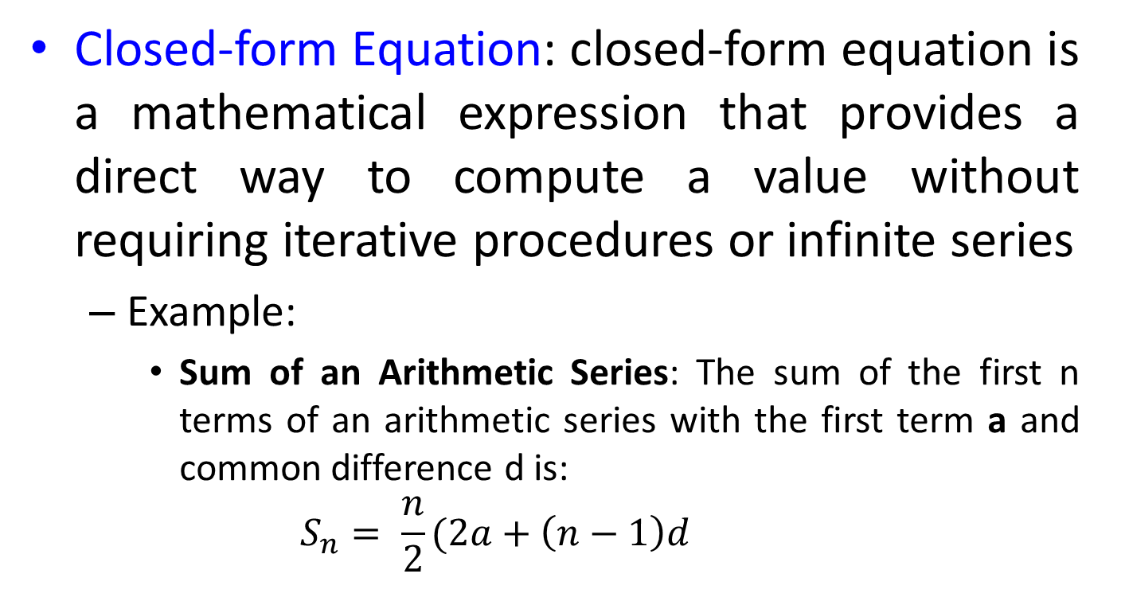
Closed-form Equation
Closed-form Equation: closed-form equation is a mathematical expression that provides a direct way to compute a value without requiring iterative procedures or infinite series
Example:
Sum of an Arithmetic Series: The sum of the first n terms of an arithmetic series with the first term a and common difference d is:
$$S_{n}= \frac{n}{2}(2a+\left(n−1\right)d$$

Slide 3
Gradient Descent
Gradient Descent is an optimization algorithm used in machine learning and deep learning to minimize the loss function by updating the model's parameters in the direction of the steepest descent
The type of gradient descent depends on how much data is used to compute the gradient at each iteration
Gradient descent is also called “the deepest downward slope algorithm”
It is very important in machine learning, where it is used to minimize a cost function

Slide 4
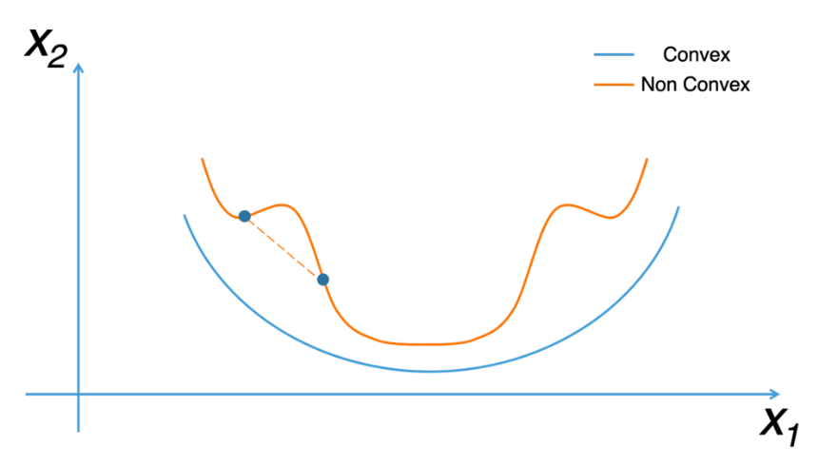

Slide 5
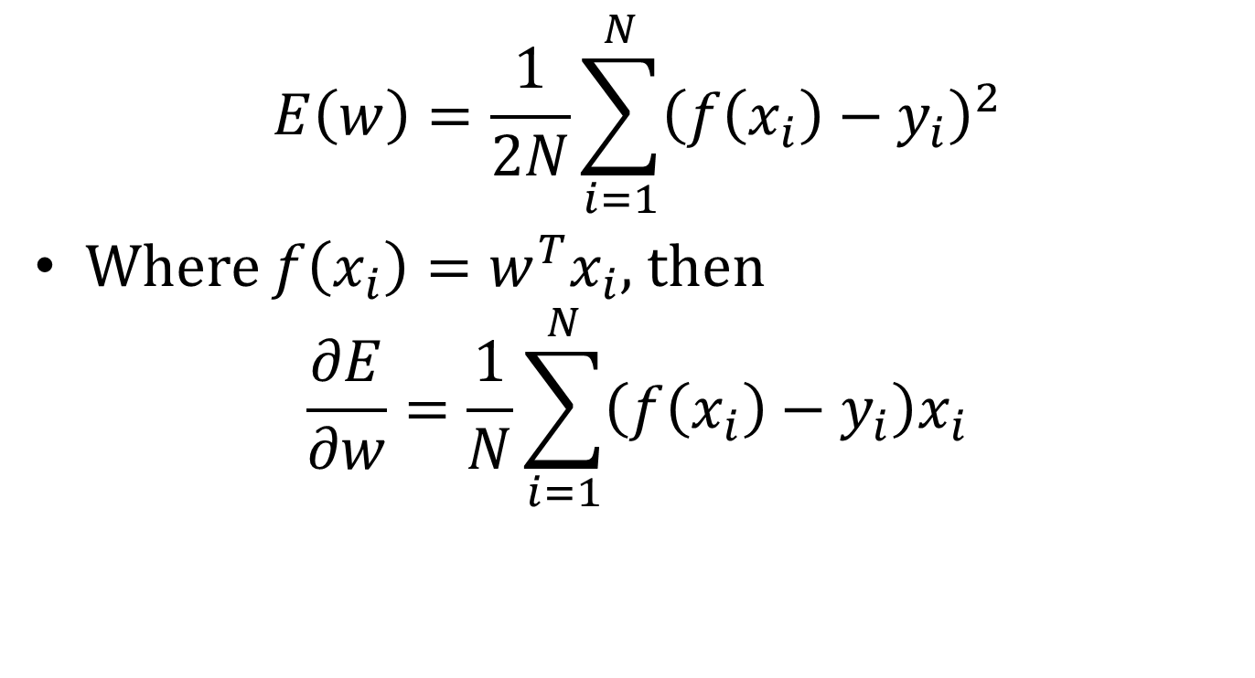
Loss function
$$E\left(w\right)=\frac{1}{2N}\sum_{i=1}^{N}{{\left(f\left(x_{i}\right)−y_{i}\right)}^{2}}$$
Where $f\left(x_{i}\right)=w^{T}x_{i}$, then
$$\frac{∂E}{∂w}=\frac{1}{N}\sum_{i=1}^{N}{\left(f\left(x_{i}\right)−y_{i}\right)x_{i}}$$

Slide 6
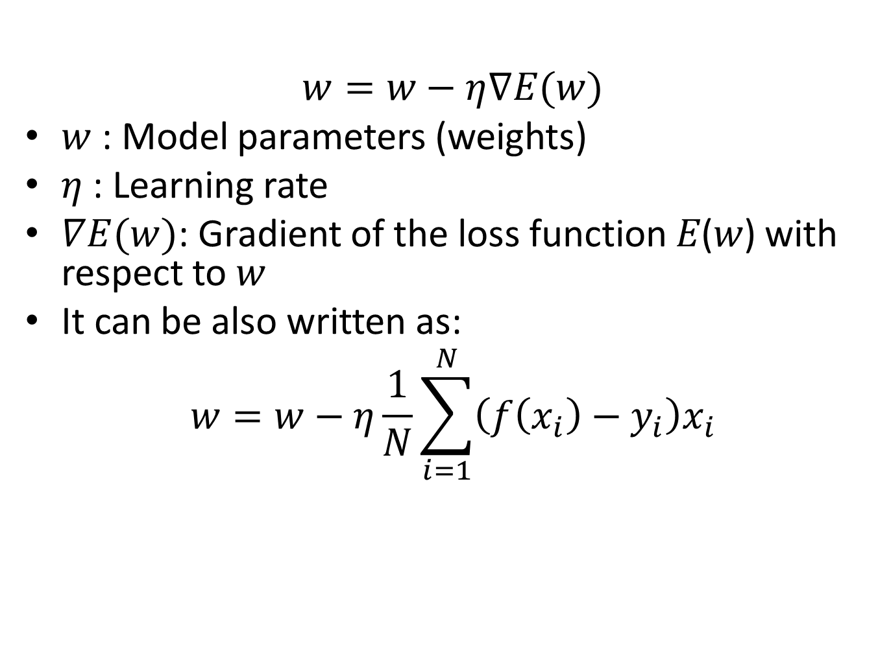
Mathematical Formulation of Gradient Descent
$$w=w−η∇E(w)$$
$w$ : Model parameters (weights)
$η$: Learning rate
$∇E(w)$: Gradient of the loss function 𝐸(𝑤) with respect to 𝑤
It can be also written as:
$$w=w−η\frac{1}{N}\sum_{i=1}^{N}{\left(f\left(x_{i}\right)−y_{i}\right)x_{i}}$$

Slide 7
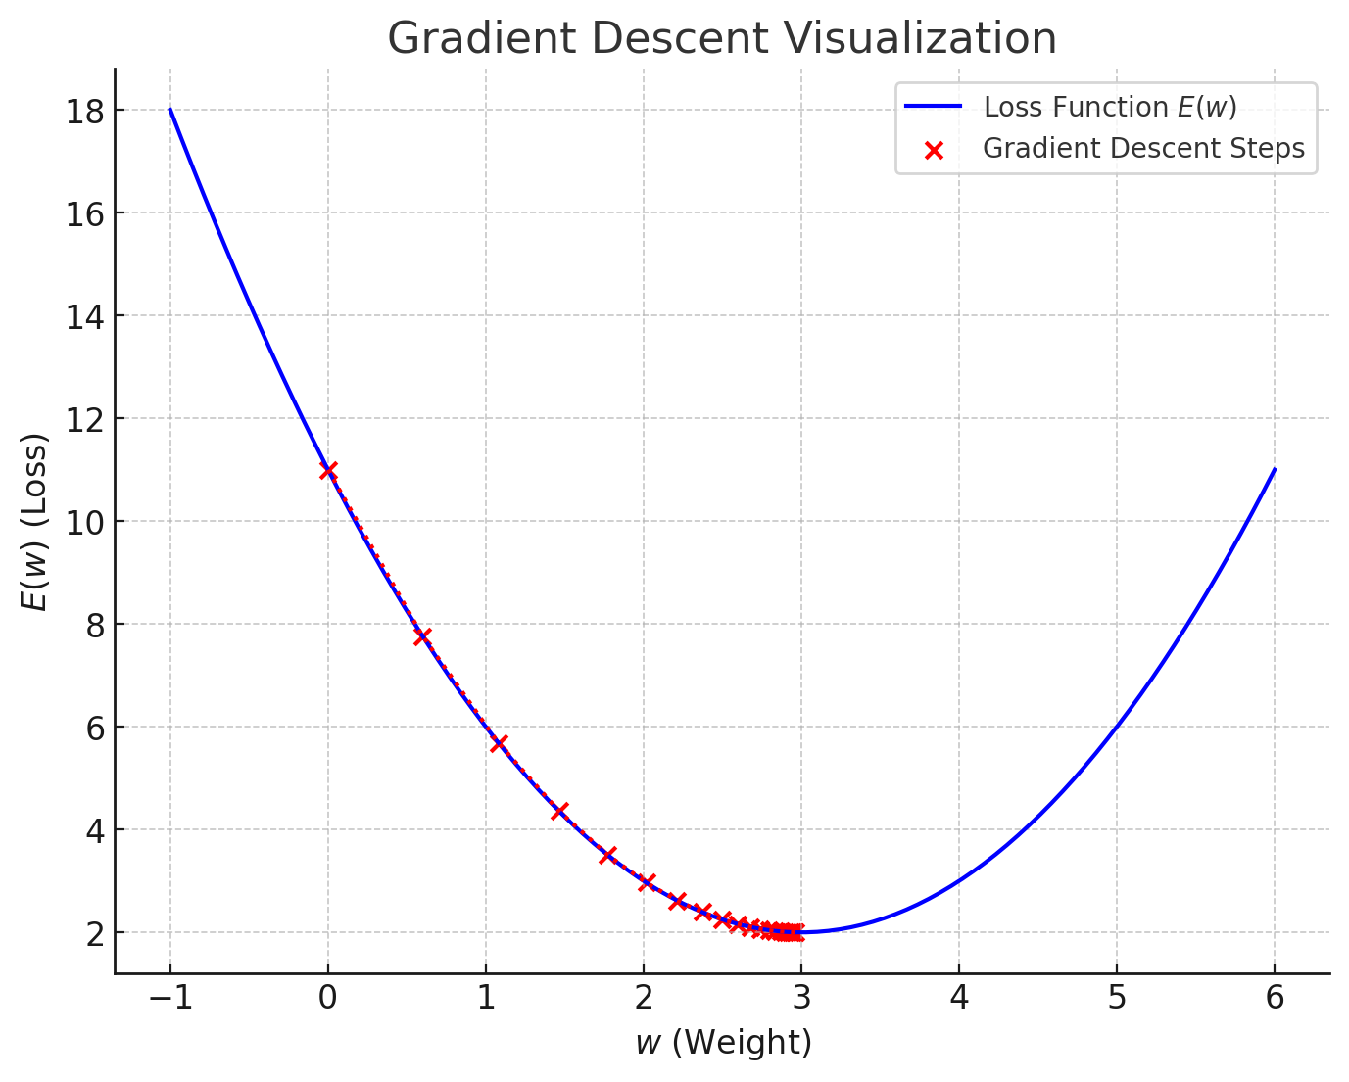

Slide 8
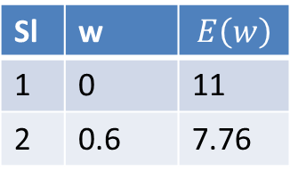
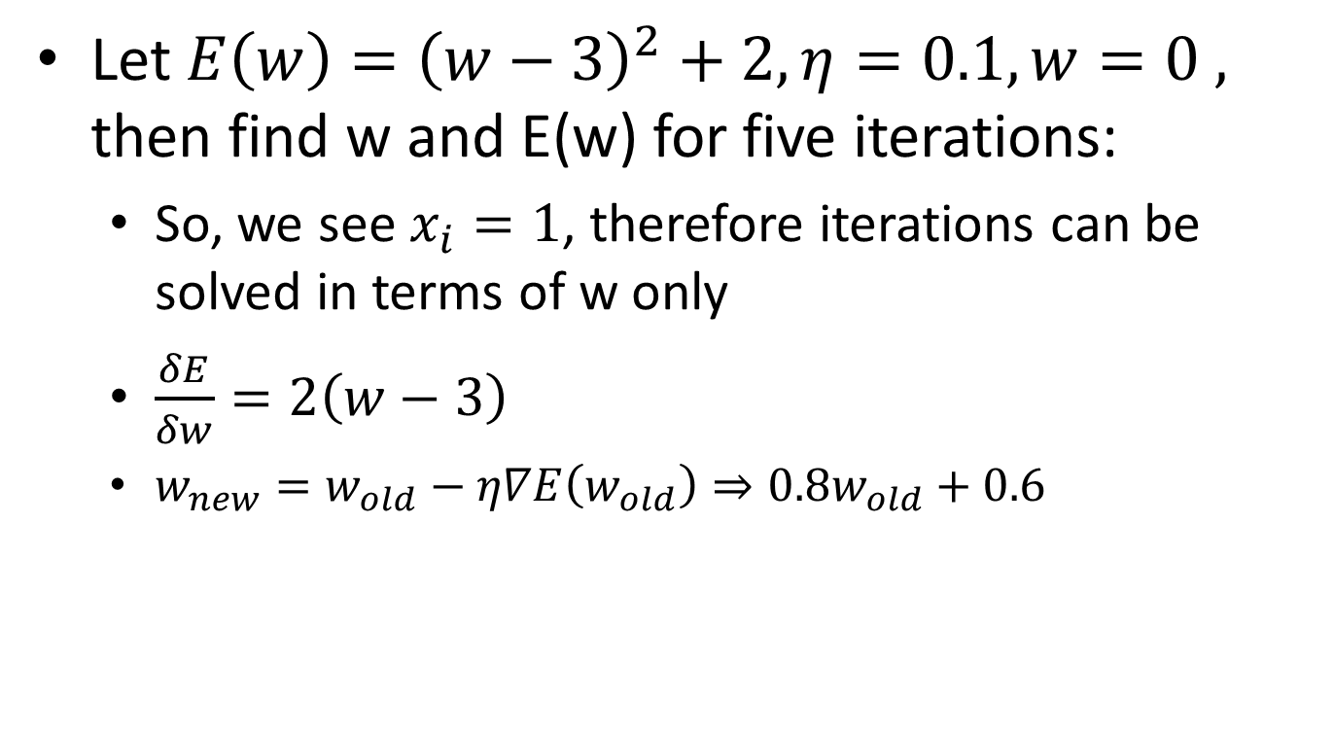
Numerical Problem
Let $E\left(w\right)={\left(w−3\right)}^{2}+2, η=0.1, w=0 ,$ then find w and E(w) for five iterations:
So, we see $x_{i}=1$, therefore iterations can be solved in terms of w only
$\frac{δE}{δw}=2\left(w−3\right)$
$w_{new}=w_{old}−η∇E\left(w_{old}\right)⇒0.8w_{old}+0.6$
Sl | w | $$E\left(w\right)$$
1 | 0 | 11
2 | 0.6 | 7.76

Slide 9
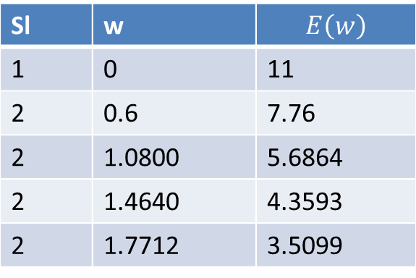
Sl | w | $$E\left(w\right)$$
1 | 0 | 11
2 | 0.6 | 7.76
2 | 1.0800 | 5.6864
2 | 1.4640 | 4.3593
2 | 1.7712 | 3.5099

Slide 10
Batch Gradient Descent
Batch Gradient Descent is an optimization algorithm used to minimize a loss function by iteratively updating the model's parameters using the entire dataset to calculate the gradient
Advantages:
Computes the gradient with high precision using the entire dataset
Converges steadily towards the minimum
Suitable for smooth and convex loss functions
Disadvantages:
Memory-intensive when the dataset is large
Requires processing the entire dataset for each iteration

Slide 11
Stochastic Gradient Descent
Stochastic Gradient Descent (SGD) is a variant of gradient descent where the model parameters are updated using only a single training example at a time, rather than the entire dataset
This leads to faster updates and can help the algorithm escape local minima, making it suitable for large datasets
Advantages
Faster Updates
Escaping Local Minima
Scalability
Disadvantages
Noisy Convergence
Requires More Iterations

Slide 12
Mini-Batch Gradient Descent
Mini-batch Gradient Descent is a hybrid approach between Batch Gradient Descent and Stochastic Gradient Descent. It aims to combine the advantages of both by updating the model parameters using a subset (mini-batch) of the training data rather than the entire dataset (batch) or just one data point (stochastic)
Mini-batch: The dataset is divided into small batches, each containing a fixed number of training examples (The size of each mini-batch (denoted as 𝑏) is a hyper-parameter)
Gradient Calculation: For each mini-batch, the gradient is calculated based on the average of the training examples in that batch
Weight Update: The model parameters are updated using the computed gradient for the mini-batch
Repeat for all mini-batches until convergence
Advantages: Faster than Batch GD, Less Noisy than SGD
Disadvantages: Choosing the Right Batch Size, Memory Considerations

